Slide 1


Tong Jing Ning
24/ 09/ 2024

Slide 2

Outline
Executive Summary
Introduction
Methodology
Results
Conclusion
Appendix

Slide 3
Executive Summary
Summary of methodologies
SpaceX Falcon 9 Launches data collection through web GET requests from SpaceX V4 API
SpaceX Falcon 9 Launches data collection through web scraping using BeautifulSoup4
SpaceX Falcon 9 Launches data wrangling with Python Pandas
SpaceX Falcon 9 Launches Exploratory Data analysis with SQL, Pandas, Matplotlib / Seaborn
SpaceX Falcon 9 Launch Sites analysis with Folium (Interactive Map)
SpaceX Falcon 9 Launch Sites analysis with Plotly Dash
SpaceX Falcon 9 Launch Prediction with Machine Learning
Summary of all results
EDA Results
Interactive Visual Analytics and Dashboard
Classification Predictive Analysis

Slide 4
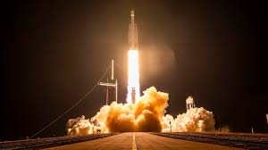
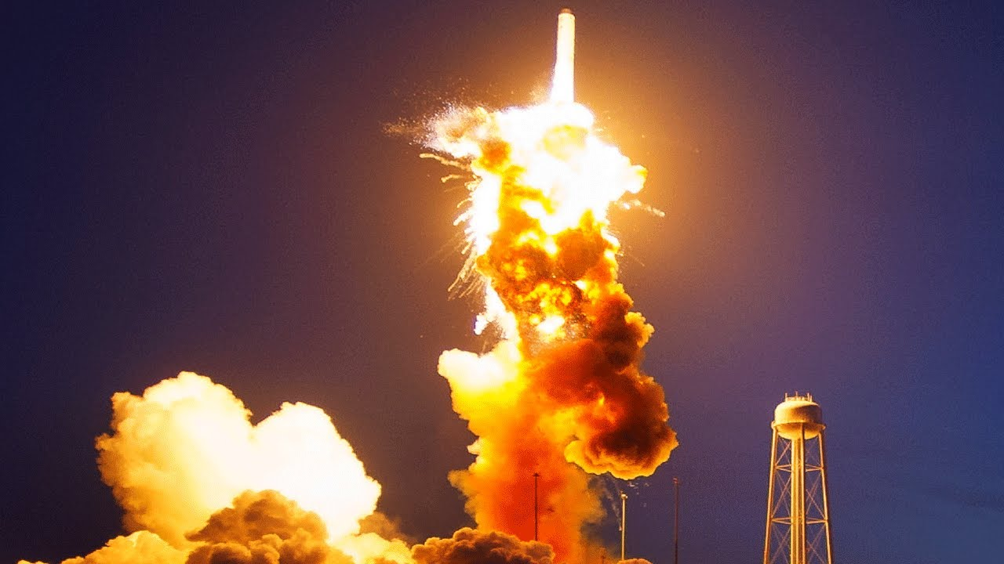
Introduction
Project Background and Context
SpaceX advertises Falcon 9 rocket launches on its website with a cost of 62 million dollars each. Much of this saving is because SpaceX can reuse the first stage. Therefore, if the first stage can be determined to land, we can determine the cost of a launch. This will be useful in business setting, for example when an alternate company wants to bid against SpaceX for a rocket launch.
Problems you want to find answers
Predict if the Falcon 9 first stage will land successfully using historical data from Falcon 9 rocket launches advertised on its website

Slide 5

Section 1

Slide 6
Methodology
Executive Summary
Data collection methodology:
Describe how data was collected
Perform data wrangling
Describe how data was processed
Perform exploratory data analysis (EDA) using visualization and SQL
Perform interactive visual analytics using Folium and Plotly Dash
Perform predictive analysis using classification models
How to build, tune, evaluate classification models

Slide 7
Data Collection
Datasets comes from a variety of sources, namely the SpaceX API and Wikipedia which stores a table of past SpaceX launches.
First, using the RESTful API of SpaceX, a GET request was made to the SpaceX API using the Python requests library. Upon successful status, a JSON text response was received. This was then parsed and normalized into a Pandas dataframe. These are all natively available through Python libraries.
In terms of web scraping, a Wikipedia page titled “List of Falcon 9 and Falcon Heavy launches” was selected as it has launch records stored in a HTML table. BeautifulSoup4 Python library is a package suitable to extract information from HTML files. The HTML text was thus parsed and preprocessed into Pandas dataframe.

Slide 8
Data Collection – SpaceX API
Yes
Python requests module
JSON response
Are there still IDs in data?
GET request
REST API
Parse and normalize JSON text
Filter Falcon9 launches
Create cleaned data DataFrame
Select features (columns)
https://github.com/syriessw/DataScienceProjects/blob/main/FinalProjects/Capstone/SpaceX%20Falcon9%20Launches%20Prediction%20Part1.ipynb

Slide 9
Data Collection - Scraping
GET request
HTML text
Python requests module
Wikipedia page
.findall(‘table’) to find Table element
Identify relevant table (3rd table)
Loop through ‘th’ element for column names
Parse HTML content with BeautifulSoup4
Yes
Is first table heading a launch number?
Assign cell element to corresponding List
Find all ‘td’ cell elements
Loop through ‘tr’ to find rows
Loop through all ‘table’, ‘wiki plainrow headers collapsible’
Create dictionary launch_dict, Key based on column names
No
Create DataFrame from launch_dict Dictionary
Add the GitHub URL of the completed web scraping notebook, as an external reference and peer-review purpose

Slide 10
Data Wrangling
Using Pandas, there are native functions we can use. Using ‘isnull().sum() allow a quick look at which columns contain empty (NULL) values. These were ‘PayloadMass’ and ‘LandingPad’.
From research, we understand that ‘LandingPad’ can be absent during launches, so NULL values are valid.
For ‘PayloadMass’, there should not be missing values. Thus, we calculate the mean value of ‘PayloadMass’ and substitute all NULL values with the mean.
To identify which features would be useful, we took a look at the number of ‘LaunchSites’ and ‘Orbit’ with value_counts.
Finally, the objective is to predict if the SpaceX launch will succeed or fail, which is equivalent to the ‘Outcome’ column. To simplify the target variable for prediction, we will recategorize into binary [0, 1] where 0 = Fail and 1 = Success.
All ‘False’ and ‘None’ prefix in ‘Outcome’ tables were used to generate ‘0’ in a new column ‘Class’. Remaining values were filled with ‘1’.
https://github.com/syriessw/DataScienceProjects/blob/main/FinalProjects/Capstone/SpaceX%20Falcon9%20Launches%20Prediction%20Part3.ipynb

Slide 11
EDA with Data Visualization
EDA with MatplotLib / Seaborn
Scatter plots to show relationship between two variables
Bar chart to show breakdown of categorical variable
Line chart to show trends across time (Year)
Scatterplot of FlightNumber vs Payload
The chart tells us as Flight number increases, the first stage is more likely to succeed. Similarly, at heavier Payloads, the flights were more successful.
Scatterplot of FlightNumber vs LaunchSite
The chart tells us as Flight number increases, the number of successes increases. We can also see that the most successful launch site is KSC LC 39A
Scatterplot of PayloadMass vs Launchsite
The chart tells us that for VAFB-SLC launch site, no rockets launched for heavy payload mass.
Bar charts on categorical variable (Orbit)
Highest success rates orbits are – ES-L1, GEO, HEO and SSO.
Scatterplot of FlightNumber and Orbit Type
In LEO orbit, the success seems to be related to number of flights. In GTO orbit, we cannot see any relationship
Line chart of Average success rate vs Year
Show the trend of mean success rate as the year goes. After 2013, the success rate keeps increasing.
https://github.com/syriessw/DataScienceProjects/blob/main/FinalProjects/Capstone/SpaceX%20Falcon9%20Launches%20Prediction%20Part5.ipynb

Slide 12
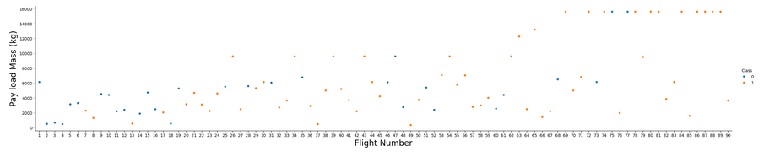
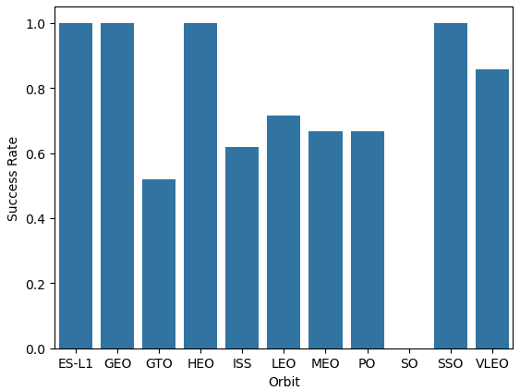
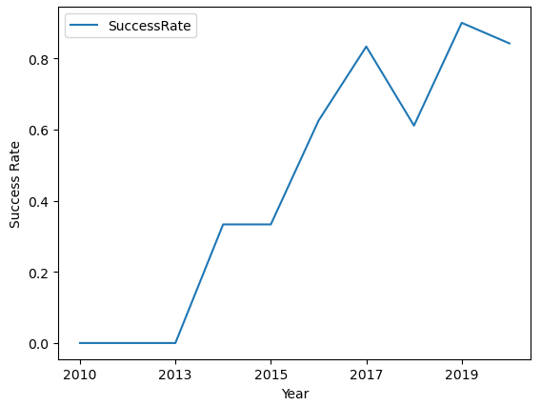
EDA with Data Visualization (Cont)
https://github.com/syriessw/DataScienceProjects/blob/main/FinalProjects/Capstone/SpaceX%20Falcon9%20Launches%20Prediction%20Part5.ipynb

Slide 13
EDA with SQL
Get all distinct Launch Sites
Find 5 launch records beginning with ‘CCA’ as launch site
Find Total payload carried by boosters by NASA (CRS)
Find average payload mass carried by booster version F9 v1.1
Find the first successful landing outcome in ground pad
Find the names of boosters that have successes in drone ship and have payload mass >= 4000 and <= 6000
List total number of successful and failure mission outcomes
List name of booster_versions that have carried the maximum payload
List records which will display the month names, failure landing outcomes in drone ship, booster versions, launch site for the months in 2015.
Rank the count of landing outcome between 2010-06-04 and 2017-03-20 in descending order
https://github.com/syriessw/DataScienceProjects/blob/main/FinalProjects/Capstone/SpaceX%20Falcon9%20Launches%20Prediction%20Part4.ipynb

Slide 14
Build an Interactive Map with Folium
Summarize what map objects such as markers, circles, lines, etc. you created and added to a folium map
In order to identify the launch sites, a marker popup and circle was created at each launch site.
Further markers in a marker cluster was added for all flights taken, with color red to represent failure, and green to represent success. These would be clustered around launch sites.
There are also additional markers added for the geographical features (coastline, railway, highway and nearest city) to the CCAFS SLC-40 launch site. A line is drawn from each feature to the launch site to show the absolute distance to the point. This helps us to explain if there is any rationale behind the location of the launch sites. We determine that launch sites must be far away from city, but near enough to railway, coastline and highway.
https://github.com/syriessw/DataScienceProjects/blob/main/FinalProjects/Capstone/SpaceX%20Falcon9%20Launches%20Prediction%20Part6.ipynb

Slide 15
Build a Dashboard with Plotly Dash
The Dashboard contains an interactable dropdown for options of All launch sites or a specific one, and a slider for PayloadMass.
There is a pie chart to showcase:
Successful launches of all sites
Distribution of launches (success and failure) of each site (determined by drop down)
There is a scatter plot to showcase:
Launches (Class) vs PayloadMass by Booster Version category (filterable by payload mass)
The pie chart tells us which site has the largest successes and which sites has the highest success rate
From the scatter plot, we can find out which payload range has the highest / lowest success, which booster version has the highest success rates and what range of payload affects the success rate.
https://github.com/syriessw/DataScienceProjects/blob/main/FinalProjects/Capstone/spacex_dash_app.py

Slide 16
Predictive Analysis (Classification)
After identifying the features, we being the analysis phase. We start off by declaring the dependant variables (X) and the target variable (Y). We will utilize sklearn machine learning library for the models.
Use train_test_split function to split the dataset into training and test samples. We retain 20% of dataset for testing.
Identify the classification models for training and evaluating
Logistic Regression
Support Vector Machine
Decision Tree Classifier
K-Nearest Neighbor
Identify the parameters to implement to search for hyperparameters
For each classification model
use GridSearch to find the best hyperparameters
Fit best parameters model with training data
Predict yhat variable with best model
Calculate accuracy, and observe the confusion matrix
Compare the accuracy and confusion matrix of all models
https://github.com/syriessw/DataScienceProjects/blob/main/FinalProjects/Capstone/SpaceX%20Falcon9%20Launches%20Prediction%20Part7.ipynb

Slide 17
Predictive Analysis (Classification) (Cont)
Is there a classification model?
Load dataset
Create features X, Y
Train_test_split
Yes
Identify set of parameters
Declare model variable
No
Draw conclusion
Compare accuracy score
Declare GridSearchCV with model, parameters and Fold = 10
Fit model
Calculate accuracy with score
https://github.com/syriessw/DataScienceProjects/blob/main/FinalProjects/Capstone/SpaceX%20Falcon9%20Launches%20Prediction%20Part7.ipynb
Plot confusion matrix

Slide 18
Results
From EDA we found that:
There is a relationship between PayloadMass, LaunchSites and Orbit
The success rate of the launches started going up after 2013.
From the Interactive Folium map, we found that:
Launch sites have to be close to coastline, railway and highway, but far away from cities.
From the Interactive Plotly Dash dashboard, we found that:
The most successful launch site is KSC LC-39A
The highest success rate launch site is CCAFS LC-40
The heavier the payload, the more the number of successes
From our evaluation of the different classification algorithm:
We find that all of them are similar in accuracy to predict whether the launches can succeed or fail.

Slide 19

Section 2

Slide 20
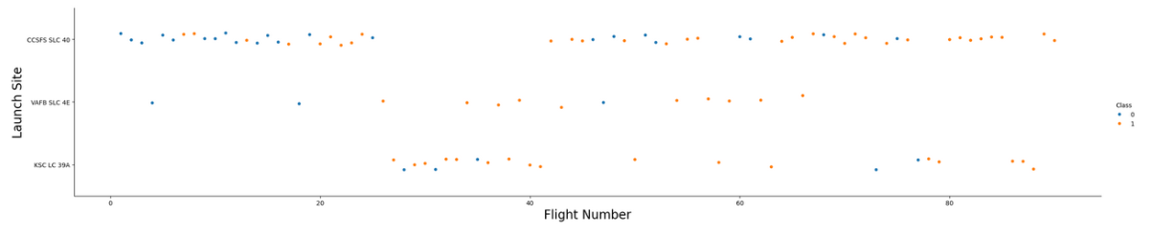
Flight Number vs. Launch Site
Site launches at VAFB SLC 4E and KSC LC 39A were rarely/not used for the first few launches until Flight Number 20 onwards. As the Flight Number goes up, the number of successes increase. The ratio of Failures to Successes are better for VAFB SLC 4E and KSC LC 39A compared to CCSFS SLC 40 launch site. However, the usage of CCSFS SLC is consistent throughout all the Flight Numbers except around Flight Numbers 25 to 40, where majority of the launches are at KSC LC 39A")

Slide 21
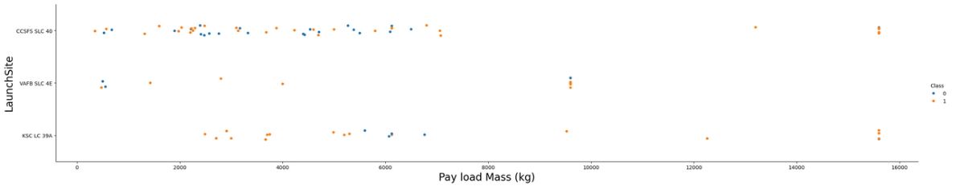
Payload vs. Launch Site
Payloads greater than 10,000kg were the most successful across all launch sites.
CCSFS SLC 40 carried the greatest variance of payloads.

Slide 22
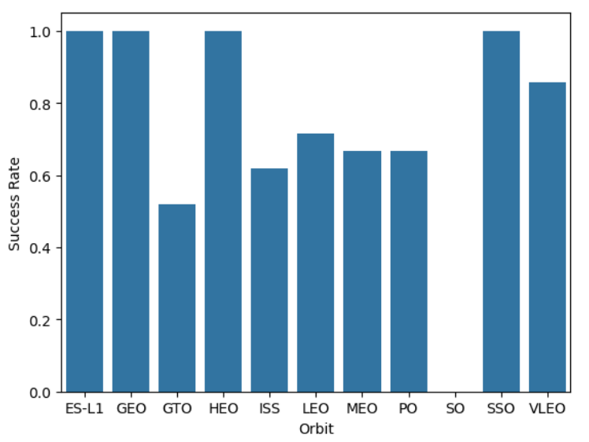
Success Rate vs. Orbit Type
Highest success rates are:
ES-L1
GEO
HEO
SSO

Slide 23
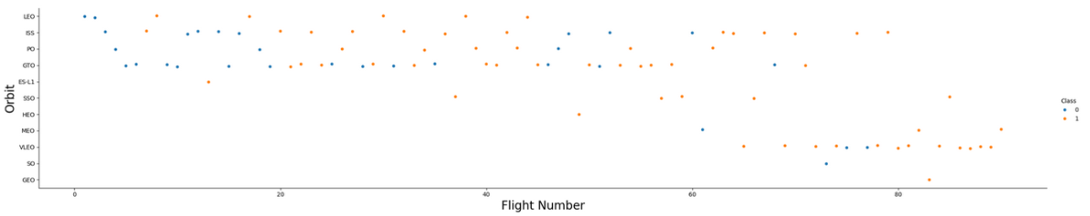
Flight Number vs. Orbit Type
LEO Orbit, as flight number increases, success increases
GTO orbit there is no direct relationship between flight number and success rate

Slide 24
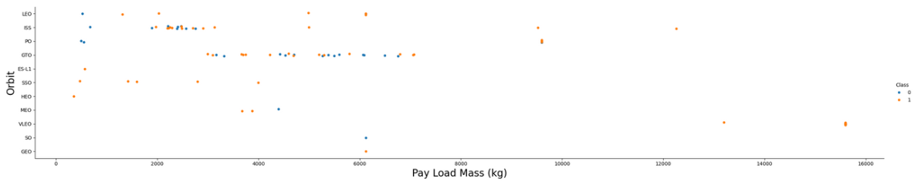
Payload vs. Orbit Type
With heavy payloads the successful landing or positive landing rate are more for Polar, LEO and ISS.
However, for GTO, it's difficult to distinguish between successful and unsuccessful landings as both outcomes are present

Slide 25
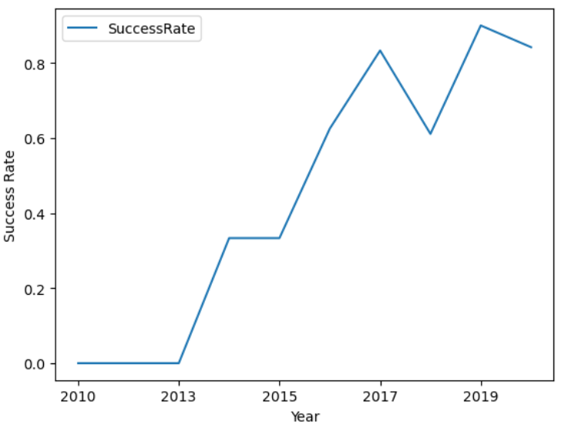
Launch Success Yearly Trend
From 2013, the success rate increase, except for 2018 where there is a dip before it follows the general trend of increasing in 2019

Slide 26
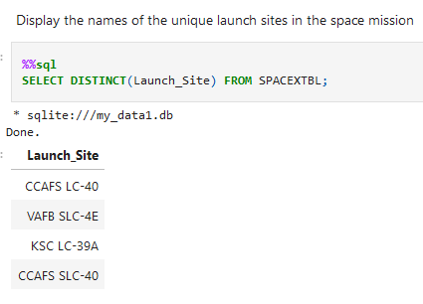
All Launch Site Names
Use DISTINCT to only pick each instance of a Launch Site in the column ‘Launch_Site’ from the table SPACEXTBL

Slide 27
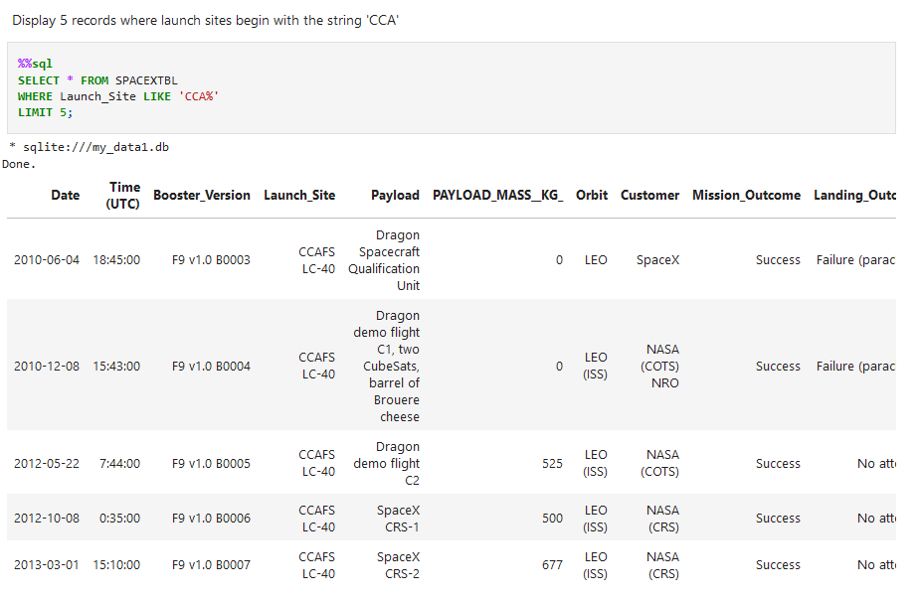
Launch Site Names Begin with 'CCA'
Use WHERE to filter the results
Use ‘LIKE’ for text comparison and ‘%’ as a placeholder to indicate any text character. Hence ‘CCA%’ means a string beginning specifically with ‘CCA’ followed by any other character
Use LIMIT to only return 5 records

Slide 28
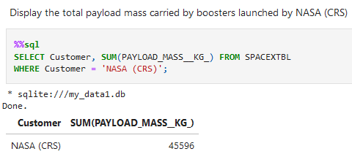
Total Payload Mass
Use SUM to aggregate all values under the column PAYLOAD_MASS__KG
Use WHERE to specify by ‘NASA (CRS)’

Slide 29
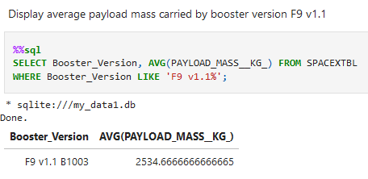
Average Payload Mass by F9 v1.1
Use AVG to aggregate and calculate mean of PAYLOAD_MASS__KG_
Use WHERE to filter the result

Slide 30
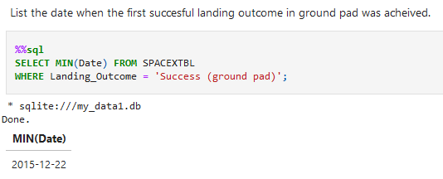
First Successful Ground Landing Date
Use MIN( ) function to calculate the smallest value from the Date column
Use WHERE to filter the result

Slide 31
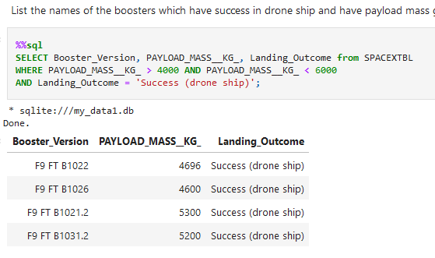
Successful Drone Ship Landing with Payload between 4000 and 6000
Use WHERE to filter result
Use > to indicate greater than
Use AND to indicate condition1 and condition2 must both equate to TRUE
< to indicate smaller than

Slide 32
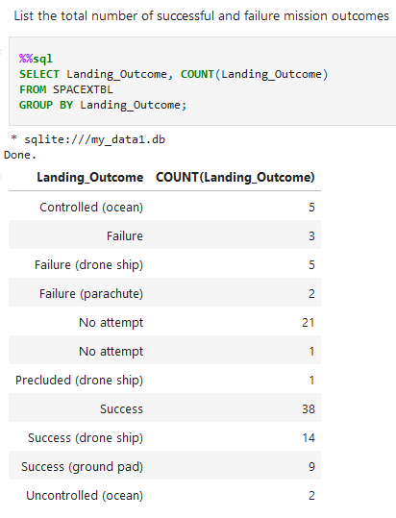
Total Number of Successful and Failure Mission Outcomes
Use COUNT( ) function to obtain the number of values in the column Landing_Outcome
Use GROUP BY to collapse/ group up all similar values into one row

Slide 33
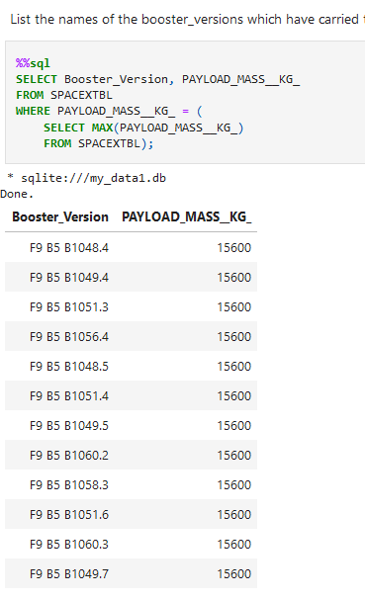
Boosters Carried Maximum Payload
Use WHERE to filter result
For the equivalent condition, use parantheses on another SQL query for a subquery
Use MAX( ) function to obtain the largest value in the column PAYLOAD_MASS__KG_

Slide 34
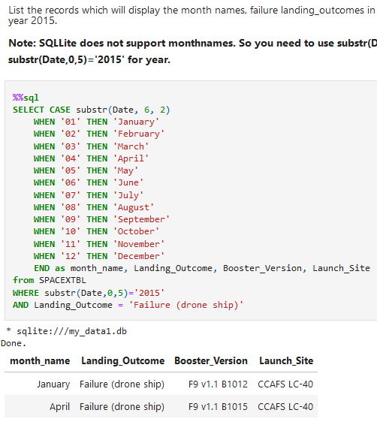
2015 Launch Records
Use CASE, WHEN, THEN to do series of IF ELSE condition to replace numerical Month as long word Month Name

Slide 35
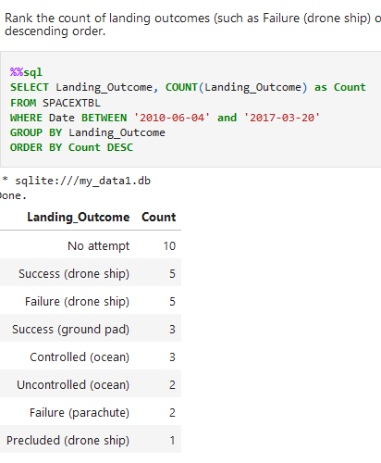
Rank Landing Outcomes Between 2010-06-04 and 2017-03-20
Use COUNT ( ) function with AS to provide an alias on the aggregated value
Use GROUP BY to group up each unique value of Landing_Outcome
Use ORDER BY with DESC to sort the result rows by given column (Count) in descending order

Slide 36

Section 3

Slide 37
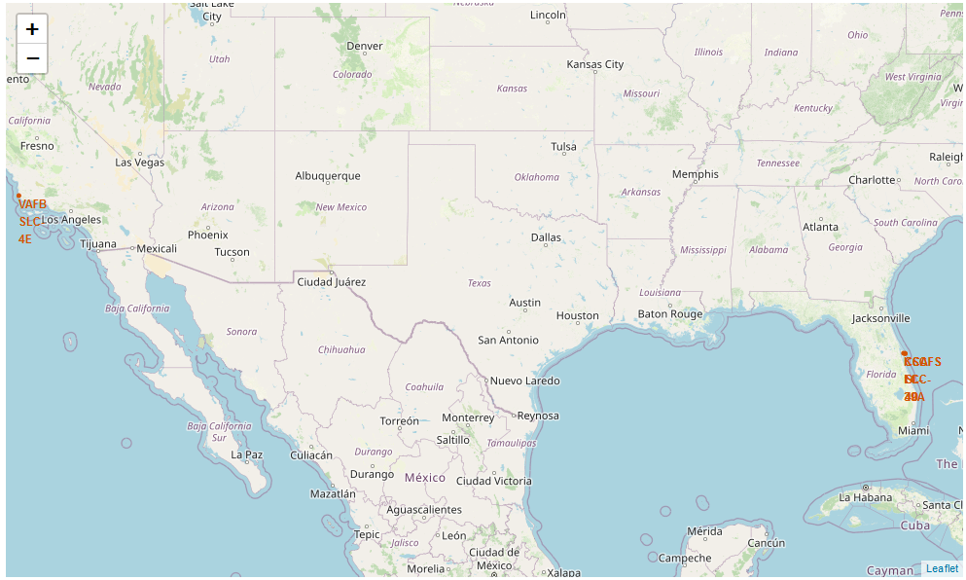
SpaceX Launch Sites on United States
The Launch sites are found on the coasts of United States
We have 1 in the West coast of US near Santa Maria
We have 3 in the East Coast near Meritt Island

Slide 38
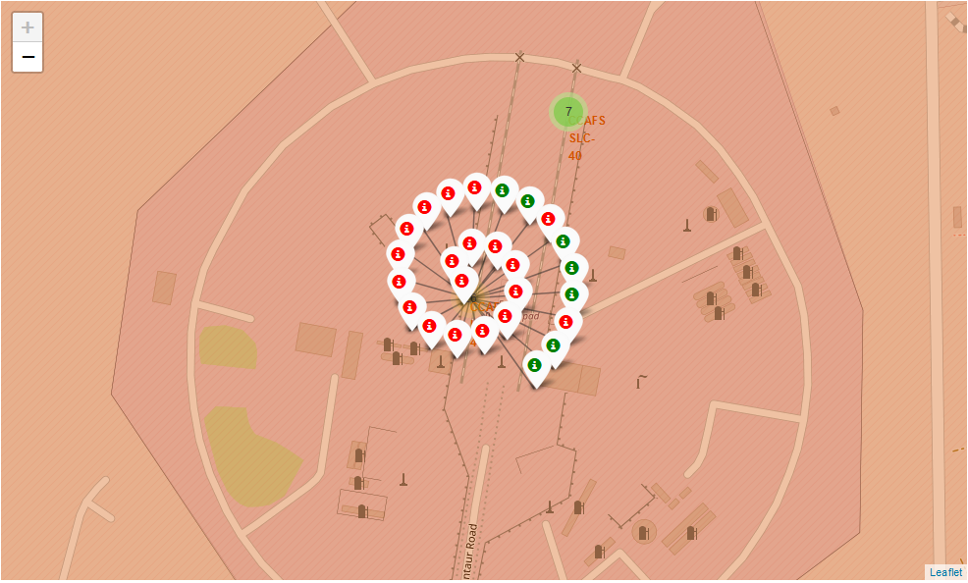
SpaceX Launch Sites Success Rates
We can see that at the CCAFS SLC-40 Launch Site, there is a greater number of failed launches compared to successful launches.
Namely:
19 Fail
7 Success

Slide 39
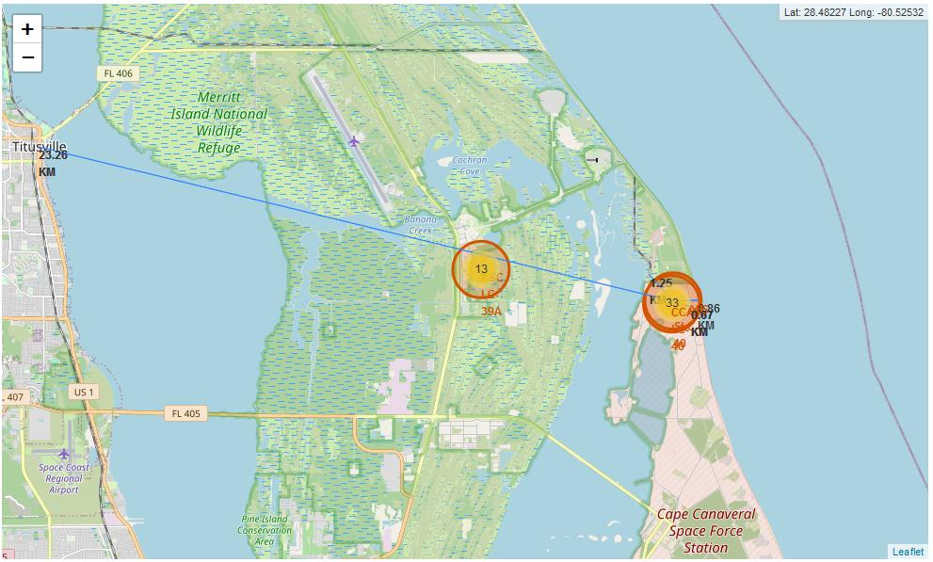
Launch Site Distances to Geographical Landmarks
We can see there are 4 lines respectively for Coastline, Railway, Highway and City
The distance from the City to the launch site is the furthest out of all of the landmarks

Slide 40

Section 4

Slide 41
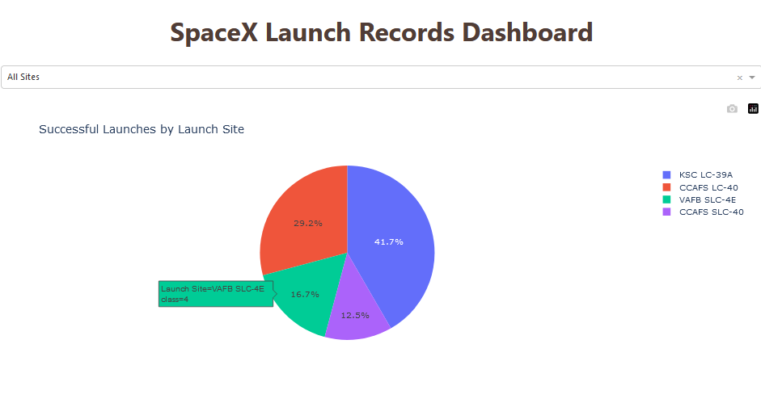
Successful Launches by Launch Site
The pie chart shows the percentage of each launch site based on their numerical count over total records
When hovered over, you can see the Launch site, and the number count of success (class = 1)

Slide 42
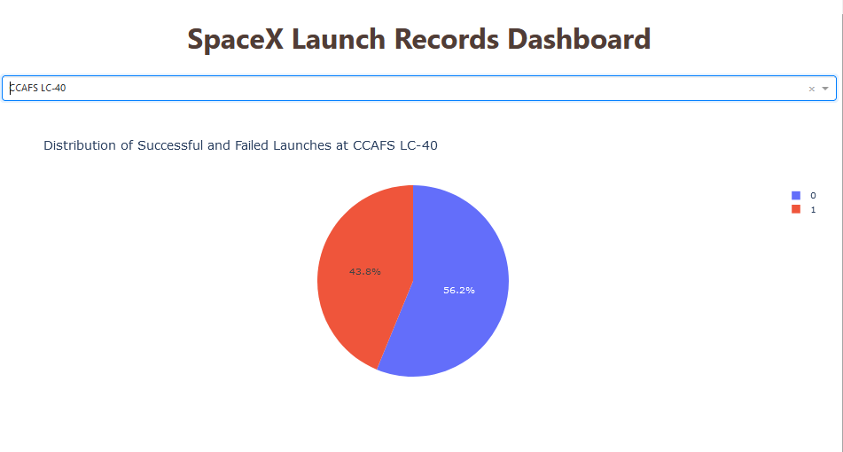
Highest Launch success rate Launch Site
The dropdown allows filtering of any specific Launch Site
The piechart will then be updated to look at all records (class =0 or 1) filtered by the launch site
We see here that CCAFS LC-40 has the highest percentage at 43.8%.

Slide 43
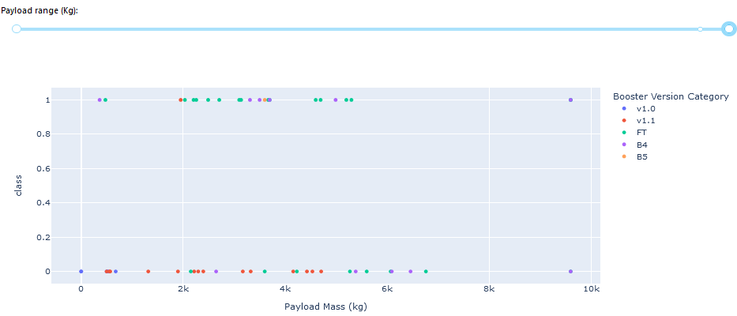
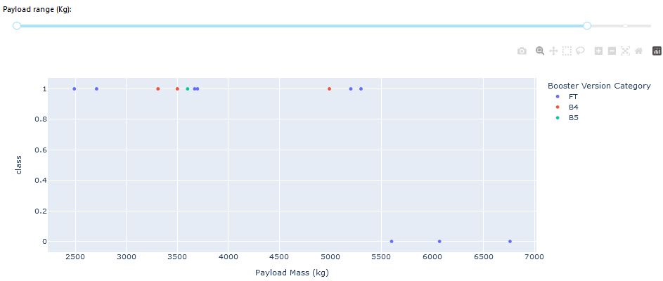
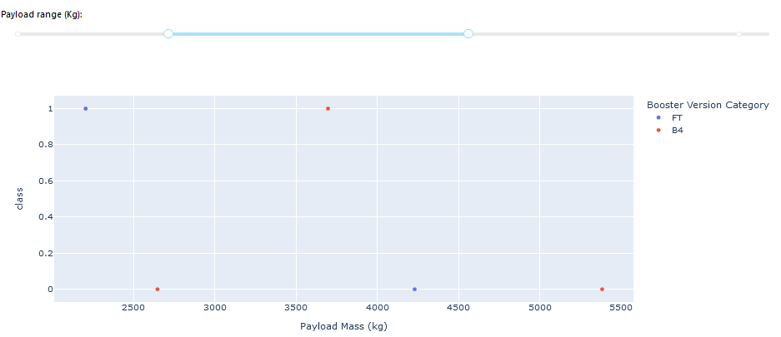
Launch Outcome vs Payload Mass
The Payload range slider allows a closer look by restricting the Payload Mass to the given min and max value
From the screenshot, we can see that between 2k to 5k payload mass yield better success results

Slide 44

Section 5

Slide 45
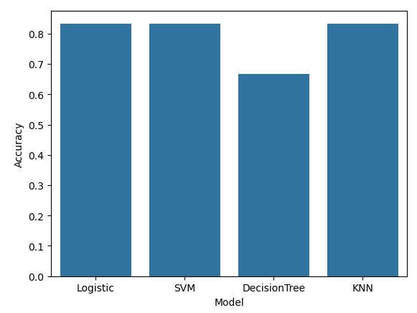
Classification Accuracy
All the models have similar accuracy except for Decision Tree at 0.8333
This is with GridSearchCV with scoring=‘accuracy’

Slide 46
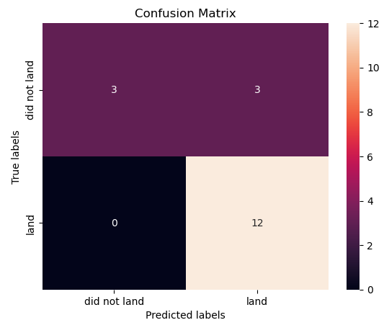
Confusion Matrix
Examining the confusion matrix, we see that the SVM can distinguish between the different classes. We see that it is similar to Logistic Regression with the same number of false positives.
Overview:
True Positive - 12 (True label is landed, Predicted labels is also landed)
False Positives - 3 (True label is not landed, Predicted labels is landed)

Slide 47
Conclusions
Our selected prediction model is SVM which has a 0.83 accuracy score against our testing data
We were able to determine the following features are dependant variables through EDA:
Launch Site
Flight Number
Payload Mass
Orbit
We did not explore all the different relationships of the other dependent variables we used such as Reused, Block, GridFins etc

Slide 48
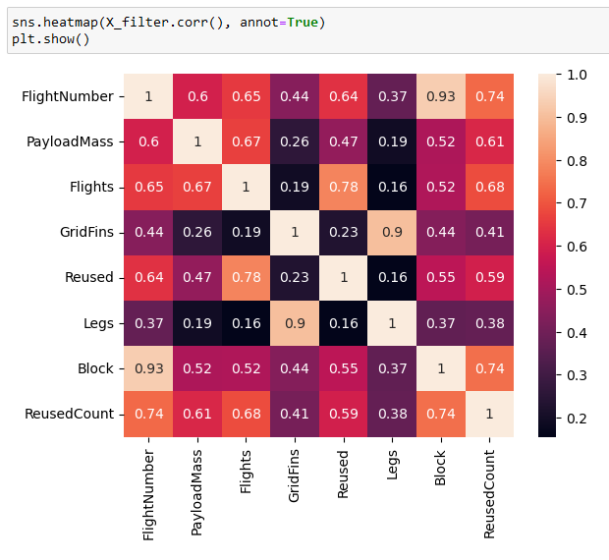
Appendix
Correlation of Boolean and continuous variables
We can see that there are weak relation between GridFins and Flights and Reused
We see strong relationship for ReusedCount and FlightNumber and ReusedCount and Flights.

Slide 49


